Slide 1
Regulatory Compliance Assistant
Team Members-
Bhawana Asija
Sunil Kumar Dubey
Rishi Ghosh
Snehal Adhyapak
Harshitha Chellamalla
Bhagyashree Devendrappa
Surya Bala Ramakrishnan
Navnirman Singh
Durga Vaidyanathan
Amisha Reddy
DATE:
Feb 7th 2025

Slide 2
Table of Contents
01
Problem Statement
02
Solution Overview
03
Demo
04
Technical Implementation
05
Path to Production & Future Enhancements

Slide 3
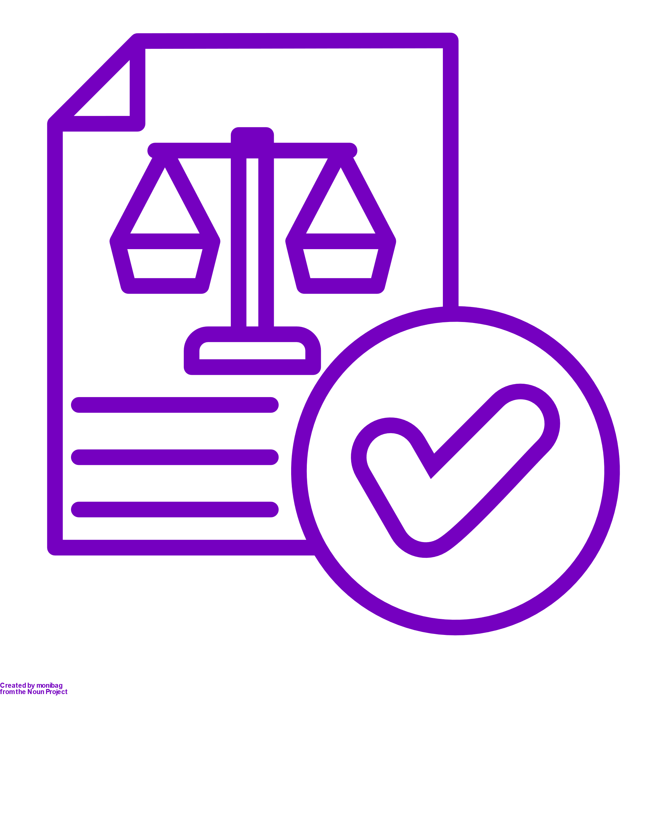



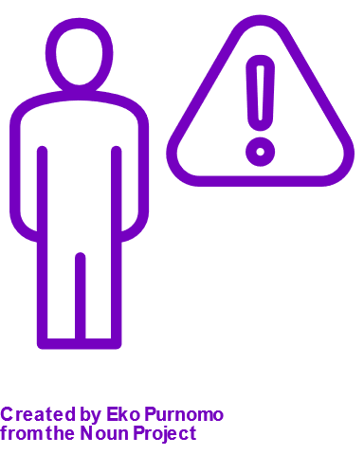

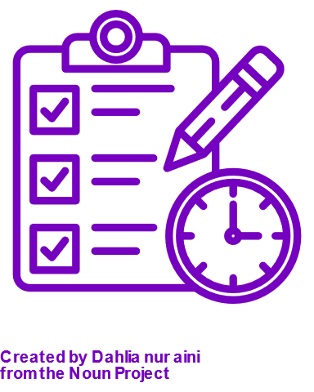

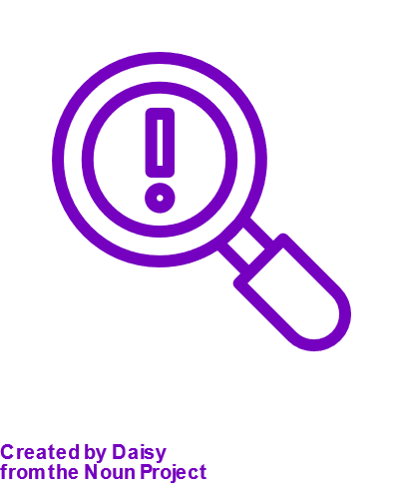
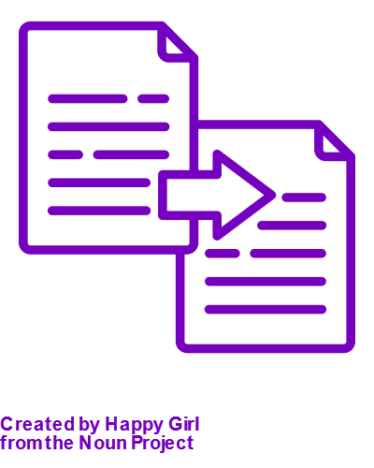
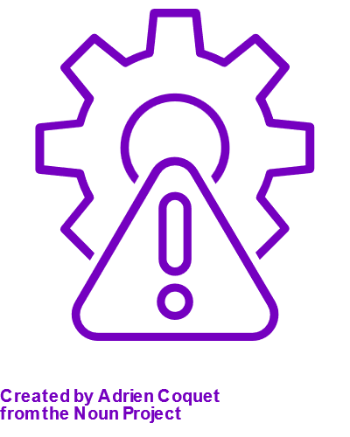
In a complex and constantly evolving regulatory environment, Firms spend significant resources to ensure adherence with regulatory changes
Firms must know and track regulations and updates to follow globally and locally
Must monitor a universe of horizon scanning of underlying laws and regulations
Regulatory and Compliance teams manually search hundreds of separate regulatory websites every day
Thousands of regulatory events, updates, proposals, rules, and executive orders are manually reviewed
Human Errors are often costly and create risk
Unclear understanding of the mapping of the regulations, policies, procedures, controls and risk
Timely review and approval of impact assessment by various stakeholders
Controls written by humans are often not up to standard and lack the 5W's (who, what, where, when, why).
Not every control in the inventory is mapped to the correct regulation, and some might not be mapped at all.
There are often several duplications of controls within the inventory making it disorganized and inefficient
Controls do not always work as they are described.
... all of which requires Firms to continuously scan for updated regulations, understand impact and uplift controls to comply – a highly manual & arduous task!
3

Slide 4

The “Regulatory Compliance Assist”
Our solution uses Generative AI to help institutions navigate highly manual Risk and Compliance processes, providing the uplift and insights needed to maintain a proactive and sustainable controls environment
Solution Components
Key Solution Features
Reg Compliance Assist
1
Reg Change summarizer
1
Automated tracking of changes in global financial regulations
Uses GenAI to identify & understand the modifications for a given regulation.
1
2
Analyze, Interpret & Summarize
Compare, Explain & Refer
Upload multiple versions of a regulations and get automated summaries on what changed, overall & by section
2
Control Applicability Assessment
Uses Gen AI to map Associated Controls to Regulatory Requirements, Risks and Policy Requirements
2
Chat with ‘Change Assist’
Knowledge Management
Productivity
Ask specific questions on “what’s new” and “what changed” between versions of the regulation
3
Gap Assessment
Uses Gen AI to identify coverage, improvements and gaps across controls
3
Controls Compliance Assist
3
Draft Communication
Automatically map L1/L2 controls to regulatory documents & identify partial compliance & suggested uplift
Benefits
Enhanced accuracy for parsing, control quality review & rationalization
Reduced risk of mis-interpretation that can lead to non-compliance​
Fully automated documents scanning and regulation parsing.
​
Significant reduction of manual effort associated with multiple steps like tracking changes, control traceability and gap analysis.
Increased compliance coverage and prioritization of gap remediation
Gen AI driven Control Design Recommendations based on new regulatory obligations
4

Slide 5
Components of the Regulatory Compliance Assistant
The Regulatory Compliance Assistant leverages Generative AI to compare regulatory changes and provides users with both a summary & an interactive interface to interpret implications as well as performs controls compliance against updated regulations
Reg Change
Impact Analysis
Compliance – Controls Traceability
User uploads the old and new version of the regulation document to the tool.
The Gen AI engine provides the user with a summary of key regulation changes as well as section-level changes. Users can also use a chatbot to ask specific questions
Automatically maps the updated regulations to controls and performs gap analysis to implement control remediations.
Document Upload
Parsing
Q&A with the data
Mappings
Gap Analysis
Change Identification
1.
2.
3.
4.
5.
6.
Updates introduced to an existing regulation
Gen AI automatically identifies document sections and themes
The tool breaks the regulation down into themes/ sub-themes
Impacted themes/sub-themes are Identified
Summary of key changes in regulation as well as theme/sub-theme wise changes automatically performed by tool
Understand the Impact
Users can chat with the tool to understand specific nuances of changes & understand impact vis-à-vis their current state
Regulation sections are Auto-mapped to Controls
User uploads controls. Using Embeddings, automatically maps the identified section of regulation to existing controls
Controls are categorised into ‘Full, Partial, No Match’
Using Embeddings, automatically maps the existing controls into full or partial match basis the updated regulation
5

Slide 6
DEMO

Slide 7
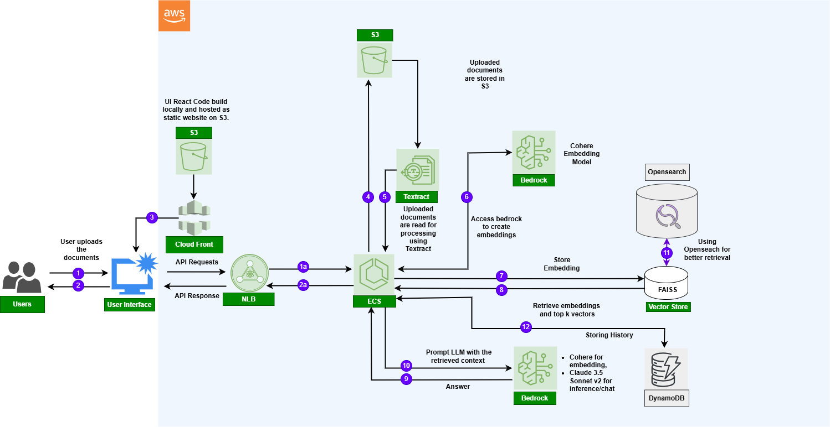
Technical Architecture
Application built on AWS, leveraging Bedrock LLM models & unstructured regulatory documents as the data source to support various personas within the compliance and risk teams.
Technology Stack
User Interface: React
Backend : Python
AWS S3 to store the documents and UI code
AWS Textract to Process and parse the documents
AWS Bedrock to access LLM Foundation Models
Cohere for embedding,
Claude 3.5 Sonnet v2 for inference/chat
AWS SageMaker for code development
Docker to dockerize the code
AWS ECS to host the dockerized code
FAISS Vectorstore to store the embedding locally
Future Enhancements
AWS DynamoDB to store the chat history
AWS OpenSearch for better context retrieval
7

Slide 8
Data Pipeline & Responsible AI guardrails
Data Pipeline
Responsible AI components
1. Knowledge Base creation
Multiple versions of Regulatory Document : For e.g. DORA (Digital Operational Resilience Act)
(ii) Organization Controls files
2. Data Preprocessing
Document Parsing- Textract + LLM & Regex used to break down regulatory documents into sections and sub-sections
VectorDB Creation- Chunking & embedding performed on documents. Embeddings saved in vector DB for semantic matching with controls.
Solution includes Bedrock ‘Responsible AI’ component that established guardrails for
Bias
Toxicity
Profanity
Denied Topics
Prompt Attacks
Sensitive Information filter etc.
on input & output in the “Chat assist” component.
The solution also checks for hallucinations and responds only from the provided context through prompt engineering.
LLM Evaluation
RAGAS Evaluation framework used to evaluate the ‘chat assist’ responses against benchmark and faithfulness score is calculated to measures the factual consistency of the generated answer against the given context
8

Slide 9



Path to Production and Future enhancements
A Scalable Regulatory Compliance tool powered by GenAI can help streamline regulatory adherence and monitoring across the industry, reducing regulatory risk and the cost of compliance
Future Enhancements
Horizon Scanning – Live regulatory change feeds from multiple agencies and jurisdictions downloaded into the regulation library where it is automatically tagged using AI
Integration with GRC Platforms – Integrating the tool with organizations existing governance, risk and compliance platform to ensure end-to-end automated workflows
Autonomous Agents for controls rationalization– to automatically identify regulations that need new controls to be created and to identify controls that need to be modified
Path to Production
Enhance the app to handle additional types of regulations and corresponding documents
Extensive testing with internal controls and policy documents with help of SMEs of the regulations
Enhance/add features like authentication, session management, logging etc.
Potential Challenges & Limitations
Data Quality & Availability - effectiveness of the tool will depend on the availability of up-to-date, consistent and complete data sources.
Required human in the loop - Regulatory bodies may not fully accept AI-driven compliance assessments, requiring human validation and legal review.
Interpretation & Contextual Understanding- Regulatory language is complex and context-dependent. While Gen AI can process large amounts of information, it may struggle with nuanced legal interpretations.
9

Slide 10
THANK YOU

